Slide 1
Applied Machine learning
Regent College London
SWE6302

Slide 2
Applied Machine learning
SWE6302

Slide 3

Machine learning
CNN, RNN & RL

Slide 4
Module 1 – CNN/Convnet

Slide 5
Learning objectives
Understand Convolutional Neural Networks (CNNs)
Understand Recurrent Neural Networks (RNNs)
Introduction to Reinforcement Learning

Slide 6
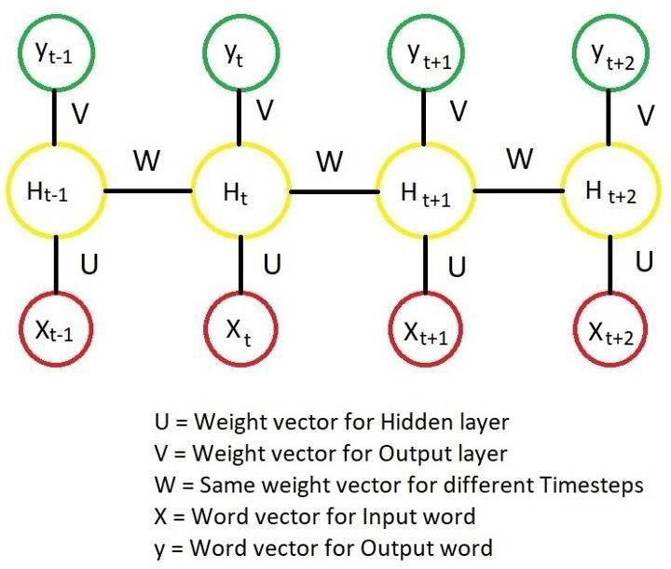
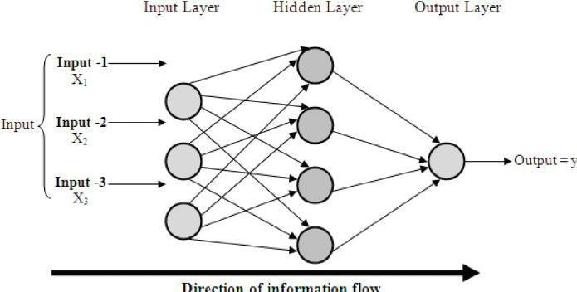
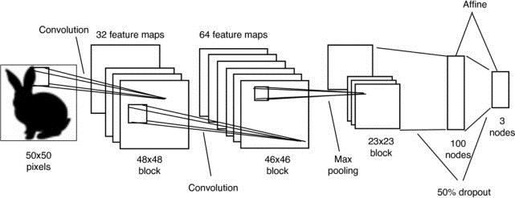
Supervised Learning with Neural Networks
Neural Network examples
Multi Layer Neural Network (MLNN)
Convolutional Neural Network (CNN)
Recurrent Neural Network (RNN)
Today’s focus

Slide 7
Convolutional Neural Networks
Convolutional Neural Networks (CNNs/ConvNets) are specialized deep learning models that excel at analyzing visual data, mimicking the human visual cortex to identify patterns in images and videos by using convolutional layers to extract features, pooling layers to reduce dimensions, and fully connected layers for classification, making them ideal for tasks like object recognition and image classification.
They learn hierarchical representations, from simple edges to complex objects, enabling them to recognize patterns regardless of their position in the input.

Slide 8
Difference between MLPN & CNN
Feature | MLP/MLN network | CNN
Layer type | Fully connected | Convolutional and pooling
Data type | Can handle any type of data | Best suited for image data
Typical applications | Image classification, regression, text classification | Image classification, object detection, semantic segmentation

Slide 9
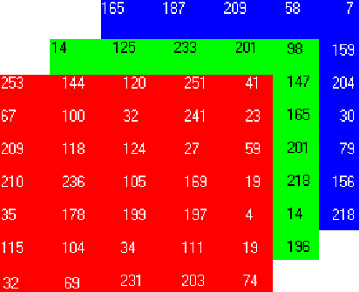
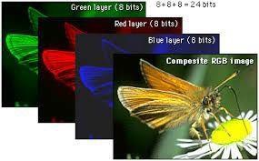
About Digital Images
A digital image consists of thousands of pixels.
An RGB image has three layers of matrices [Red,Greed,Blue]

Slide 10
Pros and cons of NN\MLP
A large dataset/image (e.g., MNIST database), can be learned using
these networks with very small error (around 2%), but
They are not suitable in capturing the spatial structure (in 2D) of the input images (each nxn image is unrolled into a vector of 𝒏𝒙𝒏 𝒙𝟏 )
Each hidden unit looks at all the units in the layer below, so pixels that are spatially separate are treated the same way as pixels that are adjacent.
There is no simple way for networks to learn the same features (e.g. edges) at different places in the input image MLP.
When input is very high dimension, we need to estimate a
large amount of parameters for a fully-connected NN .

Slide 11
CNNs can tackle these problem using
Local receptive fields in which hidden units are connected to local patches of the layer below,
Weight sharing which enables the construction of feature maps,
Pooling which condenses information from the previous layer.

Slide 12
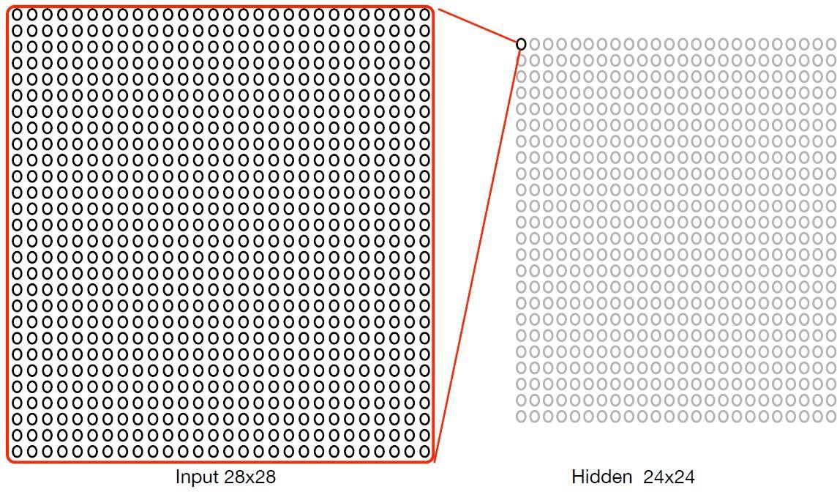
Fully connected hidden layer (576 hidden units)
When dealing with high-dimensional inputs such as images, it is impractical to
connect neurons to all neurons in the previous volume
Renals (2016)

Slide 13
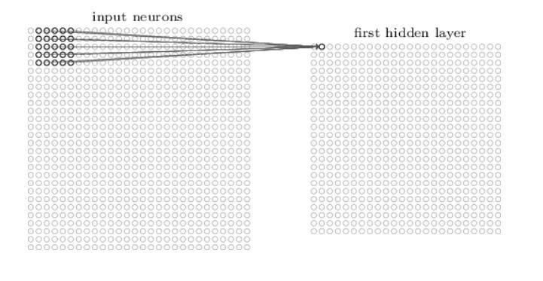
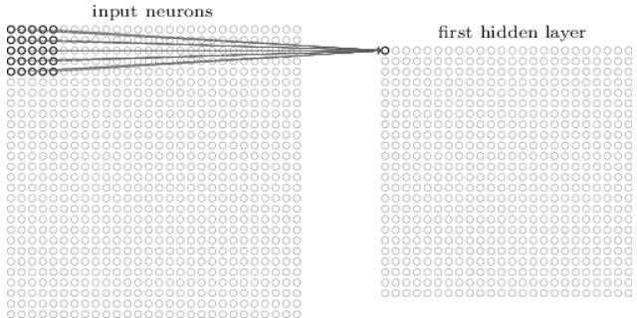
Local receptive fields (24x24 hidden units)
There is overlap between the Receptive Fields of the input matrix.
Nielsen (2017) and

Slide 14
Local receptive fields
Each hidden unit is connected to a small (𝑚 × 𝑚) region of the input space, so-called the local receptive field (LRF)
If the input space 𝑋_{𝑑×𝑑}, the hidden unit space
ℎ_{(𝑑−𝑚+1)×(𝑑−𝑚+1)}. (in the case of stride=1)
Each ℎ_{𝑖} (hidden unit) extracts a feature from its region of input space
In the previous slide, the RF field (stride length) is 1, but could be larger

Slide 15
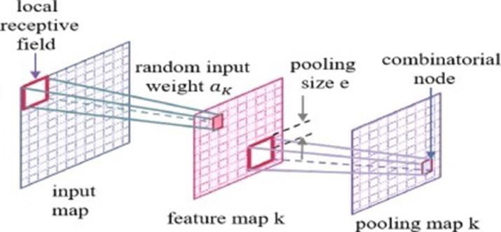
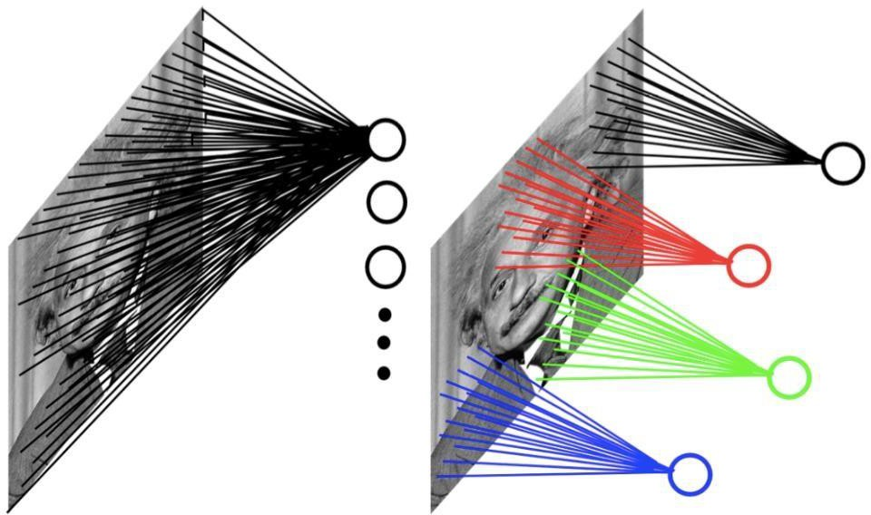
🞄 In CNNs, hidden units are only connected to local receptive field.
Example: 200x200 image
a) fully connected: with
40,000 hidden units =>
1.6 billion parameters
b) CNN: 5x5 kernel, 100 feature maps => 2,500 parameters. (the same kernel weights are used for the whole image)

Slide 16
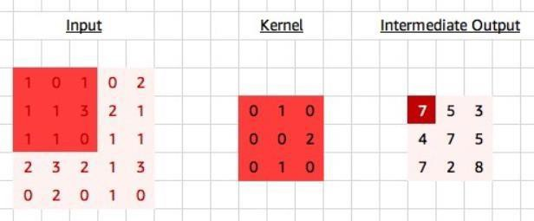
Weight sharing
Each hidden unit, ℎ_{𝑖,𝑗} is constrained to extract the same feature
by sharing weights across the RFs
For hidden unit ℎ_{𝑖,𝑗}
W (RF)
00
https://medium.com/apache-mxnet/multi-channel- convolutions-explained-with-ms-excel-9bbf8eb77108

Slide 17
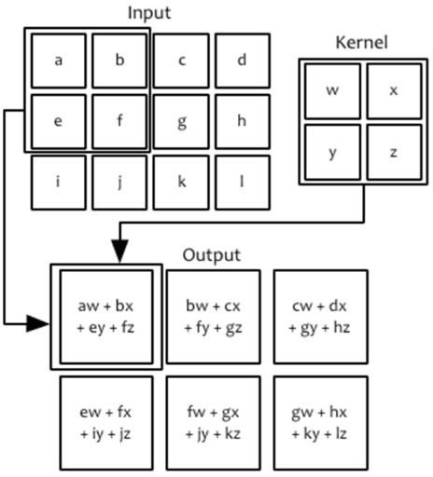
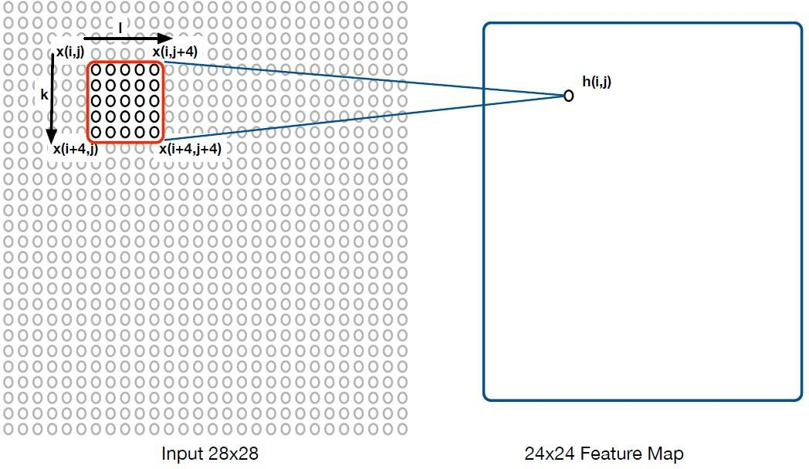
Shared weights in RFs (Receptive Fields)
𝑚−1 𝑚−1
ℎ_{𝑖,𝑗} = ෍ ෍
𝑘=0 𝑙=0
^{𝑤}𝑘,𝑙^{𝑥}𝑖+𝑘,𝑗+𝑙

Slide 18
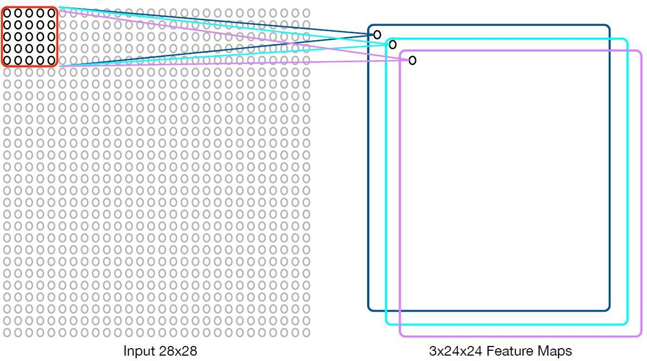
Multiple feature maps illustration
Usually there are multiple feature maps, one for
each convolution operator.

Slide 19
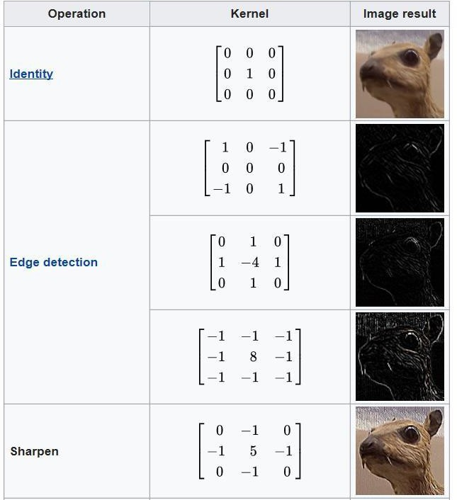
Learning image kernels
Image kernels have been designed and used for feature extraction in image processing (e.g. edge detection)
However, we can learn multiple kernel functions (feature maps) by optimising the network cost function
Automating feature
engineering
https://en.wikipedia.org/wiki/Kernel_
(image_processing)

Slide 20
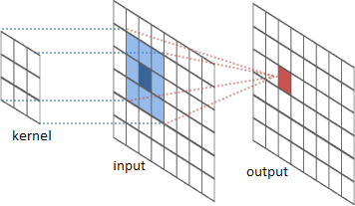


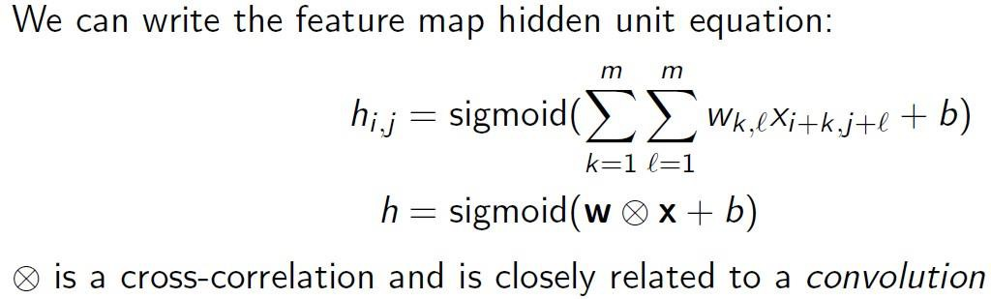
Convolution Layer
Convolution is an operation on two functions of a real-valued argument.
Feature space
Kernel
Input
Raviv (2016)

Slide 21
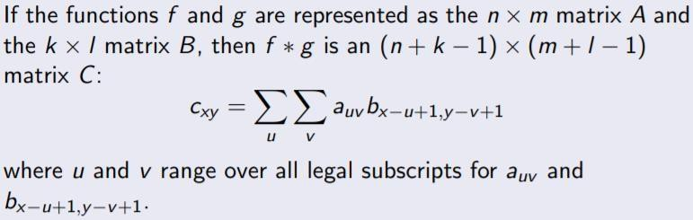
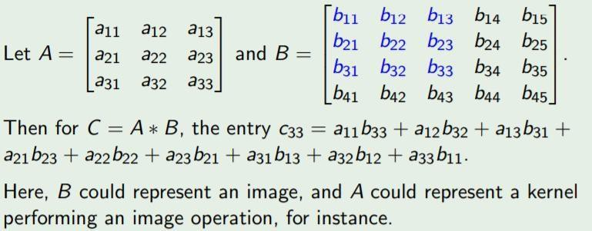
Matrix Convolution
𝑐11
[𝑐21
𝑐31
𝑐12 𝑐13 …
𝑐22 𝑐23
𝑐32 𝑐33 …
]

Slide 22
Pooling or subsampling
Pooling takes a feature map and reduces it in size (e.g., it
transforms a set of 2x2 regions to a single unit).
Pooling functions
  Max-pooling : computes the maximum value of the units in the region
  𝑳_{𝒑}-pooling: uses the 𝐿_{𝑝}norm of the units in the region:
– Average (sum pooling): take the average (sum) value of the pool
Information reduction: pooling removes precise location
information for a feature
Apply pooling to each feature map separately

Slide 23
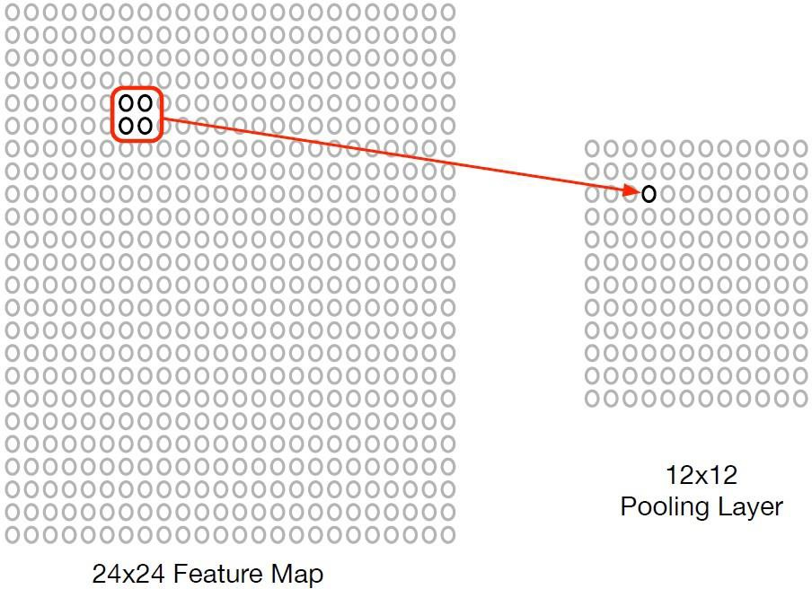
Pooling or subsampling

Slide 24
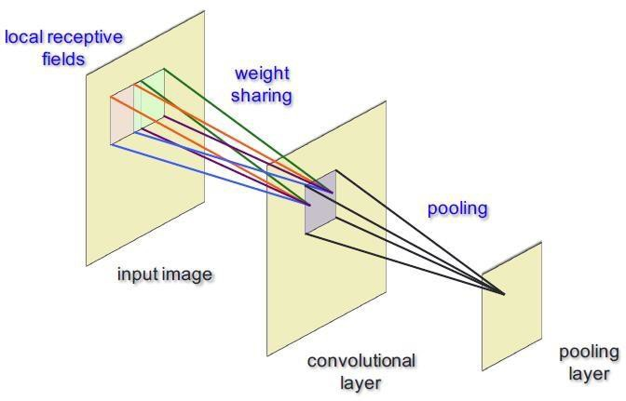
Pooling layer
Common pooling operations:
  Max pooling: reports the maximum output within a rectangular
neighborhood.
  Average pooling: reports the average output of a rectangular neighborhood (possibly weighted by the distance from the central pixel).

Slide 25
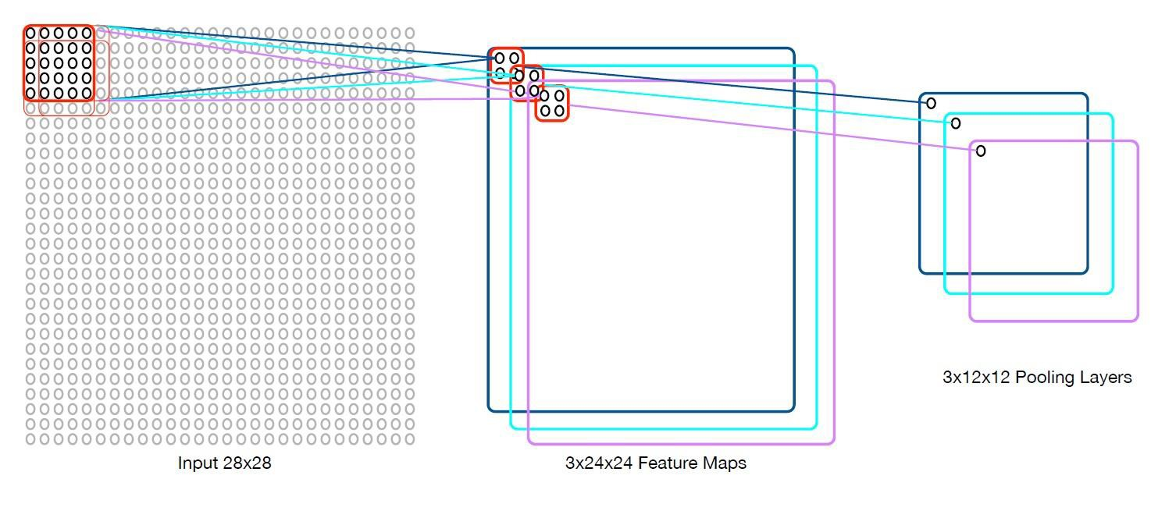
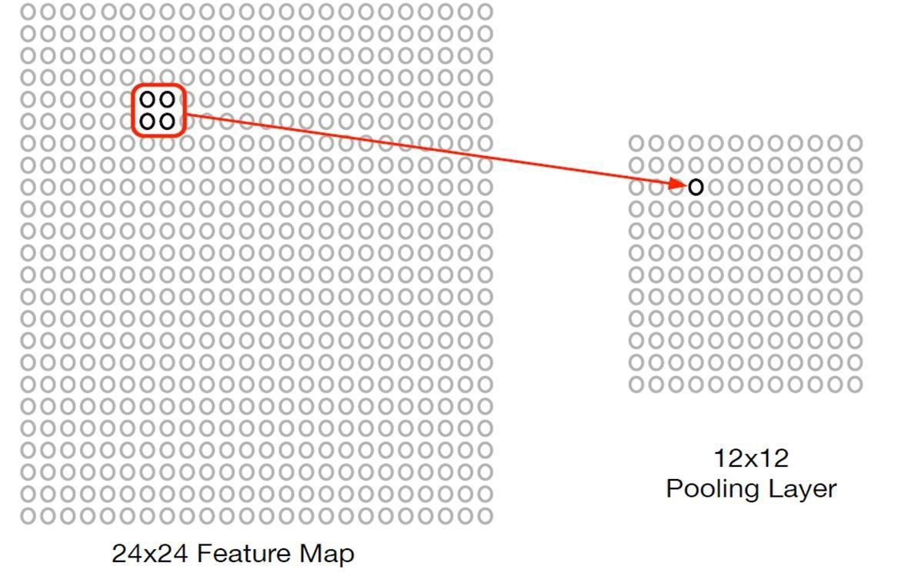
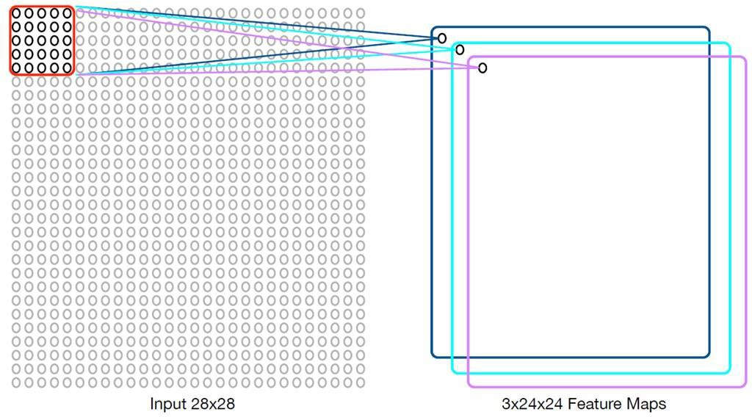
Combining convolutional &pooling layer together

Slide 26
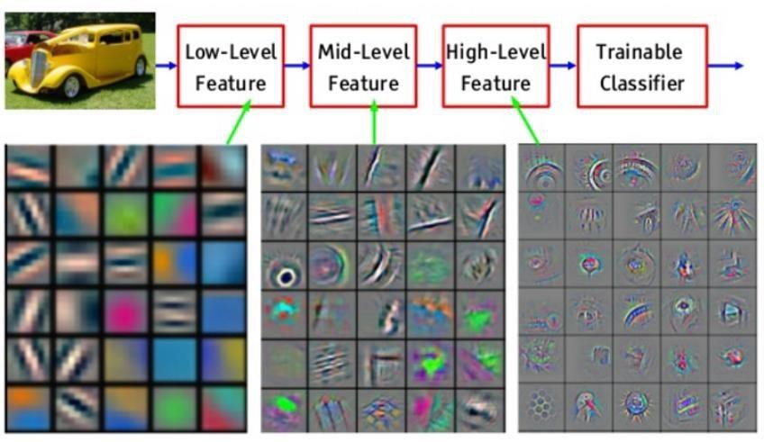
Interpretation:
Convolution/activation(F.map)+pooling=>Convolution/activation (F.map)+pooling=> ….

Slide 27
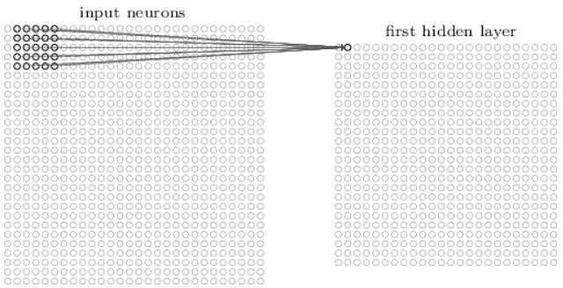
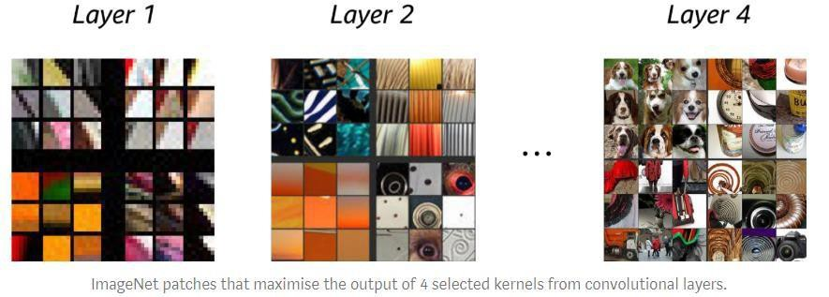
Examples
Example of the ImageNet patches that resulted in maximum weight response to four kernels in convolution.
Based on the type of kernel, different features can be detected. If
only one kernel be used, then only one type of feature will be extracted.
Clearly for tasks as complex as image classification, object detection and
the
segmentation more than one feature is required at each layer of
network.
https://medium.com/apache-mxnet/multi-channel-convolutions-explained-with-ms-excel-9bbf8eb77108

Slide 28
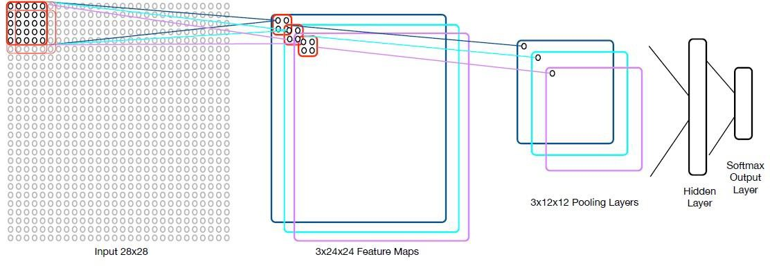
Convolutional Network (ConvNet)
ConvNet/CNN Architecture
20x12x12 pooling layer
20x24x24 feature map
Simple ConvNet:
Convolutional layer with max-pooling
Final fully connected hidden layer (no sharing weight)
Softmax output layer (converts numbers to
probabilities), one probability per class.(totally 10 classes in MNIST)
With 20 feature maps and a final hidden layer of
100 hidden unit, 289630 weights need to be estimated
20 × (5× 5 + 1) + (20×12×12× 100 + 100) + (100 ×10 + 10) = 289630
number of weights

Slide 29
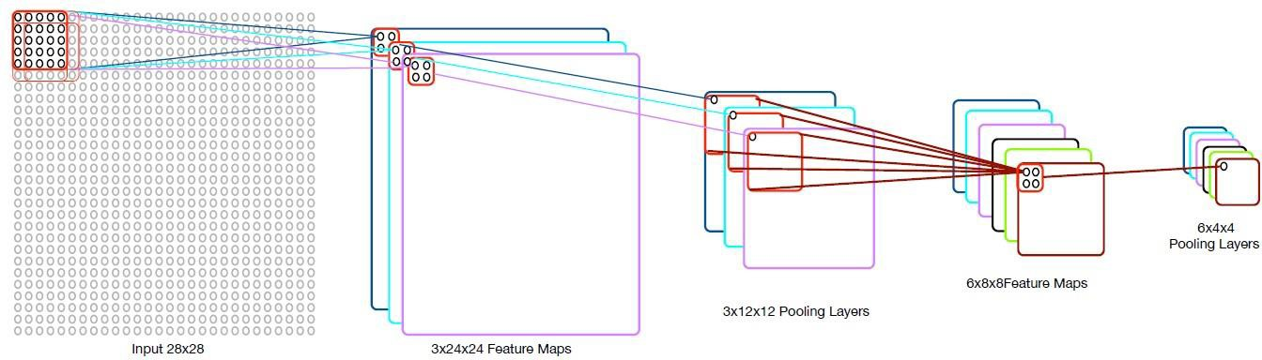
Stacking convolutional layers
28-5(kernel dim.)+1=24
12-5(kernel dim.)+1=8
3 kernels down sampling 6 kernels down sampling
Stacking will generate different levels of features, low, mid ,
high.

Slide 30

Let’s see CNN in practice
Access Google Colab Notebook:
https://colab.research.google.com/drive/1QKq26Z6DkH30QXEDRerE8V-csVxiwkBD?usp=sharing
Check out the code under “Using Simple Convolutional Neural Networks (CNNs)” section

Slide 31
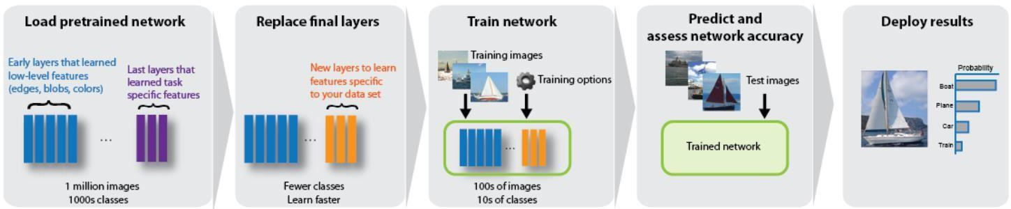
Transfer Learning
Reuse a pre-trained model (e.g. AlexNet, VGG16,etc.)
Millions of images were used to learn low-mid-high level features (e.g. ImageNet)
Only in the last three layers the decision is made. It calculates how similar are those features to any of the classes under study.
Then, I have a small data set with other images and classes, e.g.(instead of cars, I have animals), I still can use those learnt feature weights , but change the last three layers.
I use my small data set of animals to retrain the last three layers. Measure the similarity of features to animal types rather than cars!

Slide 32
Module 2 – RNN

Slide 33
Recurrent Neural Networks (RNNs)
Recurrent Neural Networks (RNNs) are a class of artificial neural networks designed to process sequential data (like text, time-series, or audio) by implementing feedback loops, allowing information to persist. Unlike standard neural networks that treat inputs independently, RNNs use a "hidden state" (memory) to remember previous inputs, making them ideal for context-dependent tasks like language translation and speech recognition.

Slide 34
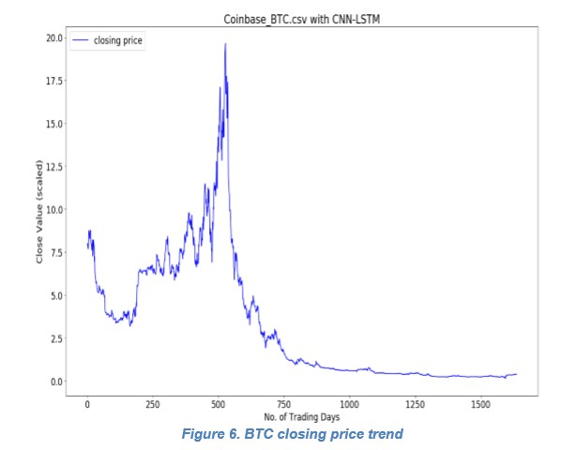
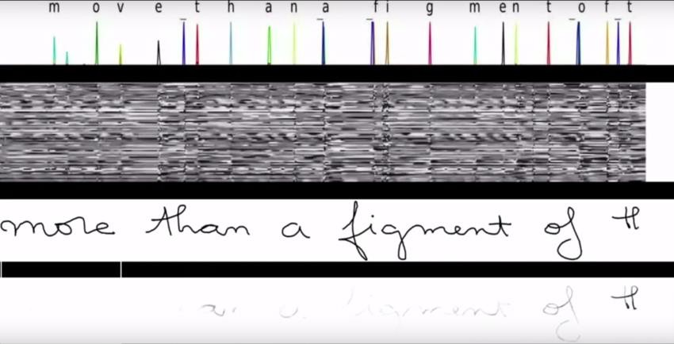
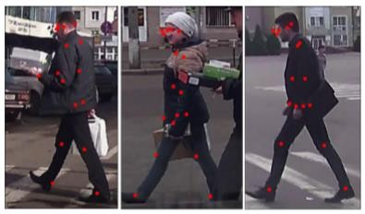
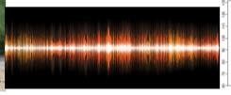
Sequential Data
We often wish to model data that is a sequence or trajectory through time, e.g., sequences of characters/words, currency exchange rates, motion of an object, audio signals

Slide 35
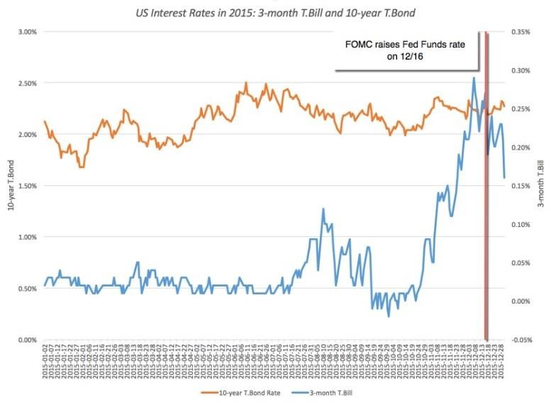
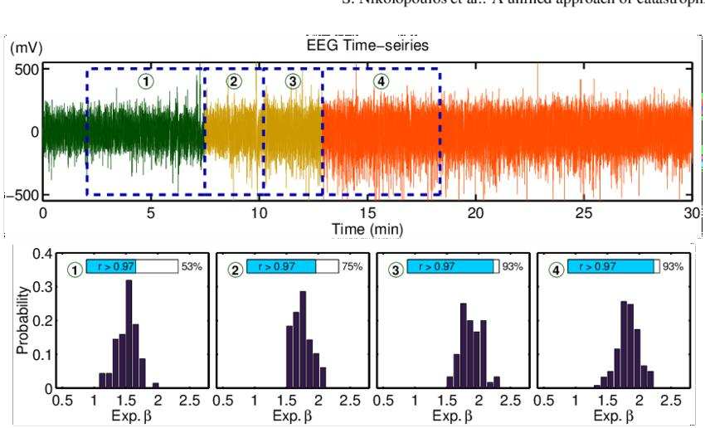
Time Series
Time series: sequence of values measured at successive moments of time
Applications:
  Prediction of Currency
exchange rate evolution
  Prediction of Stock price evolution
  Biological signals (EEG) Processing
  Wireless sensor networks
  etc.
Aim: predict the future value(s) in the series based on past values

Slide 36
Neural networks for Time Series
Neural networks for time series processing:
Feed-forward neural network with delayed input layer
Recurrent Neural networks

Slide 37
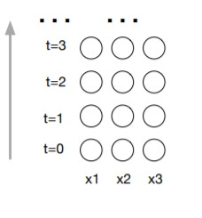
Modelling time series using NNs
How can we model a time sequence of 3D vectors?

Slide 38
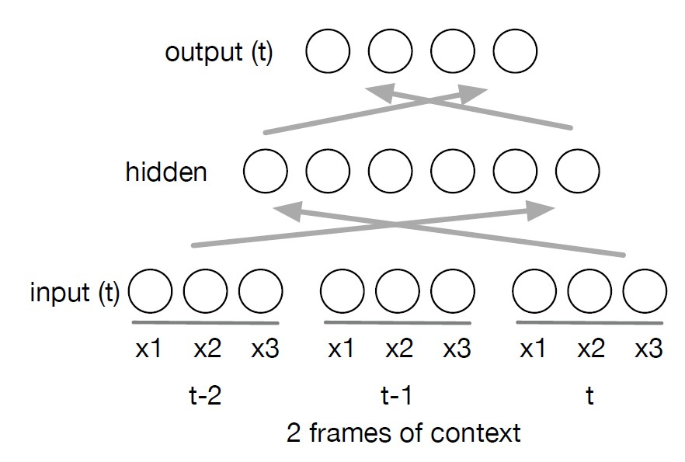
Modelling sequence data
We could model fixed context with a feed-forward network with previous time input vectors added to the network input

Slide 39
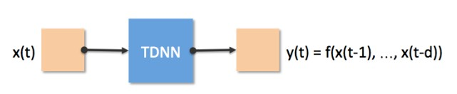
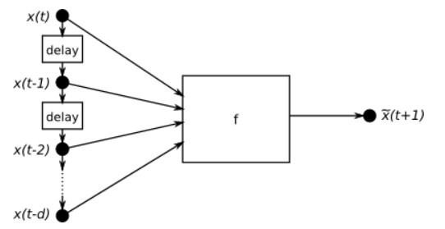
Time-delay neural network
A time delay neural network (TDNN) is a type of artificial neural network that is specifically designed to process sequential data, such as time series data. TDNNs work by introducing time delays into the network architecture, which allows them to model the temporal relationships between the input data points.
Output layer from time t-1 are used as inputs to the hidden layer at time t

Slide 40
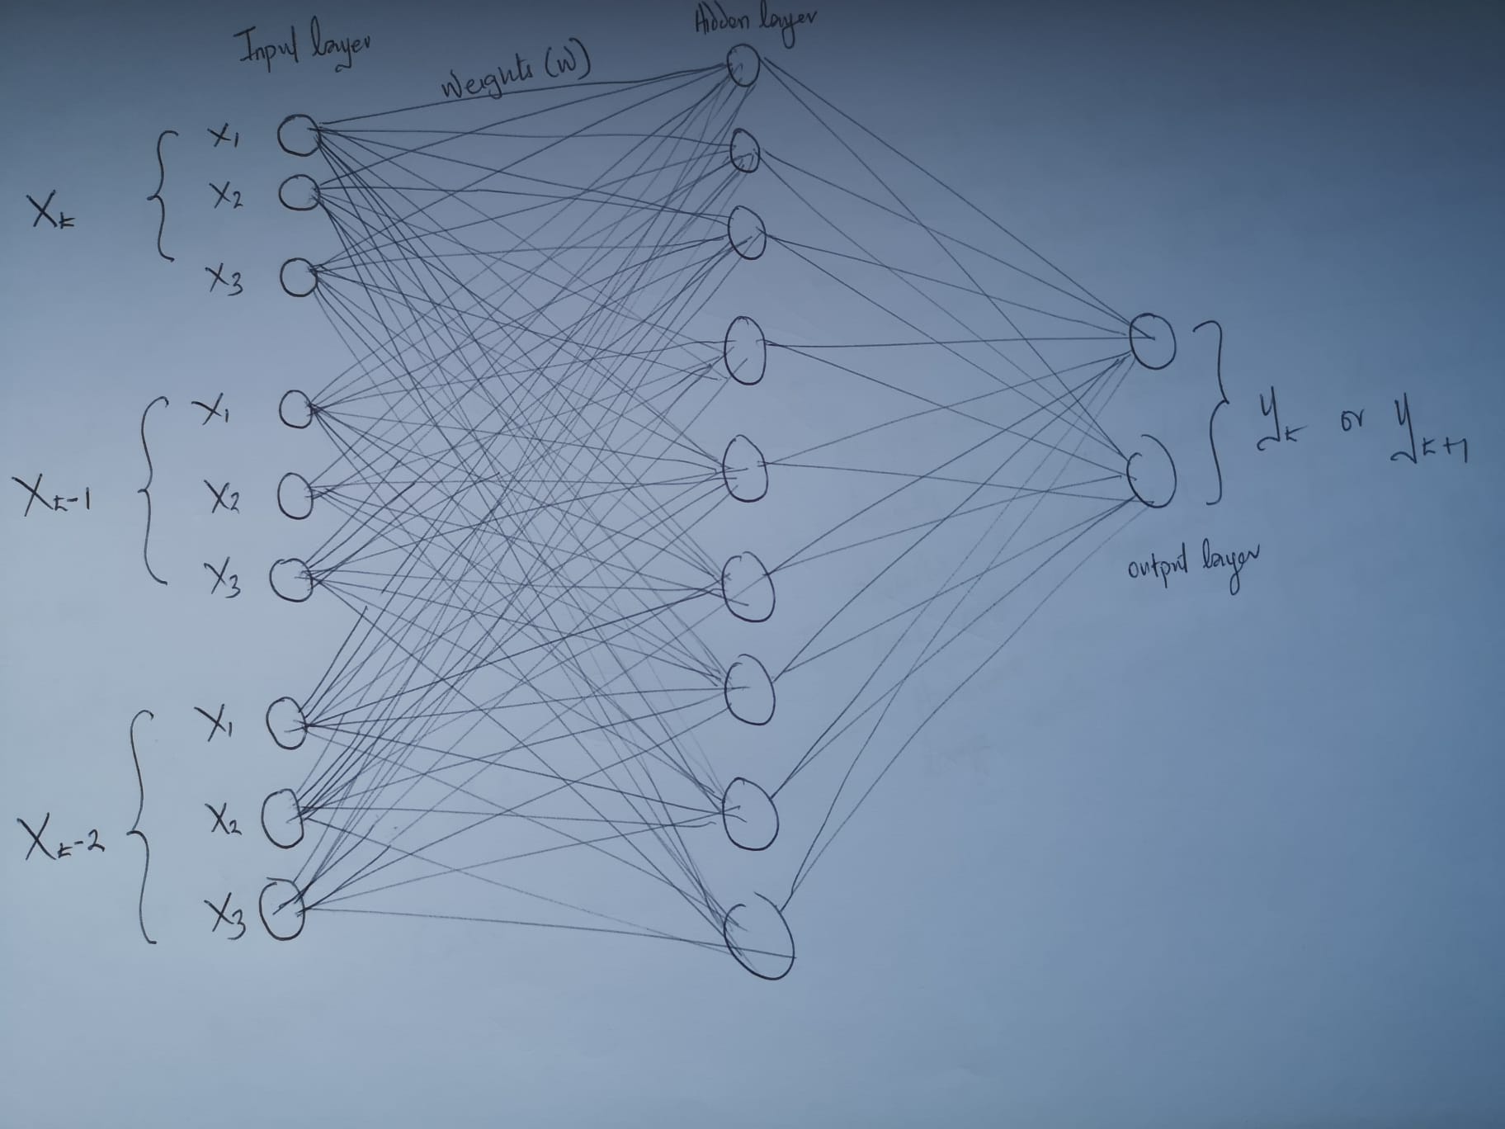
Time Delay Neural Network Architecture

Slide 41
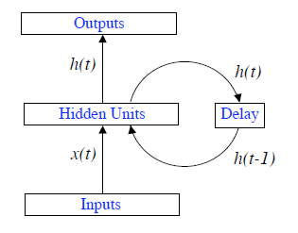
General form of RNNs
RNNs are (connectionist) models with the ability to selectively save and pass information across sequence steps, while processing sequential data one element at a time.
Allow a ‘memory’ of previous inputs to persist in the network’s internal state, and thereby influence the network output
ℎ 𝑡 = 𝑓_{𝐻} 𝑤_{𝐼𝐻}𝑥 𝑡 + 𝑤_{𝐻𝐻}ℎ(𝑡 − 1)
𝑦 𝑡 = 𝑓_{𝑂}(𝑤_{𝐻𝑂}ℎ(𝑡))
𝑓_{𝐻} and 𝑓_{𝑂} are the activation function for hidden and output
The simplest form of fully recurrent neural network is an MLP with the previous set of hidden unit activations feeding back into the network along with the inputs
unit; 𝑤 , 𝑤
, and 𝑤 are
𝐼𝐻 𝐻𝐻 𝐻𝑂
connection weight matrices which are learnt by training

Slide 42
What are RNNs good for:
As RNNs have internal states, RNNs can remember things and recall some time later (ignoring the current inputs).
RNNs can learn sequential (e.g., time series) data.
But, it is hard to train a recurrent network. This is done with the so called “BackPropagation” through time algorithm.

Slide 43
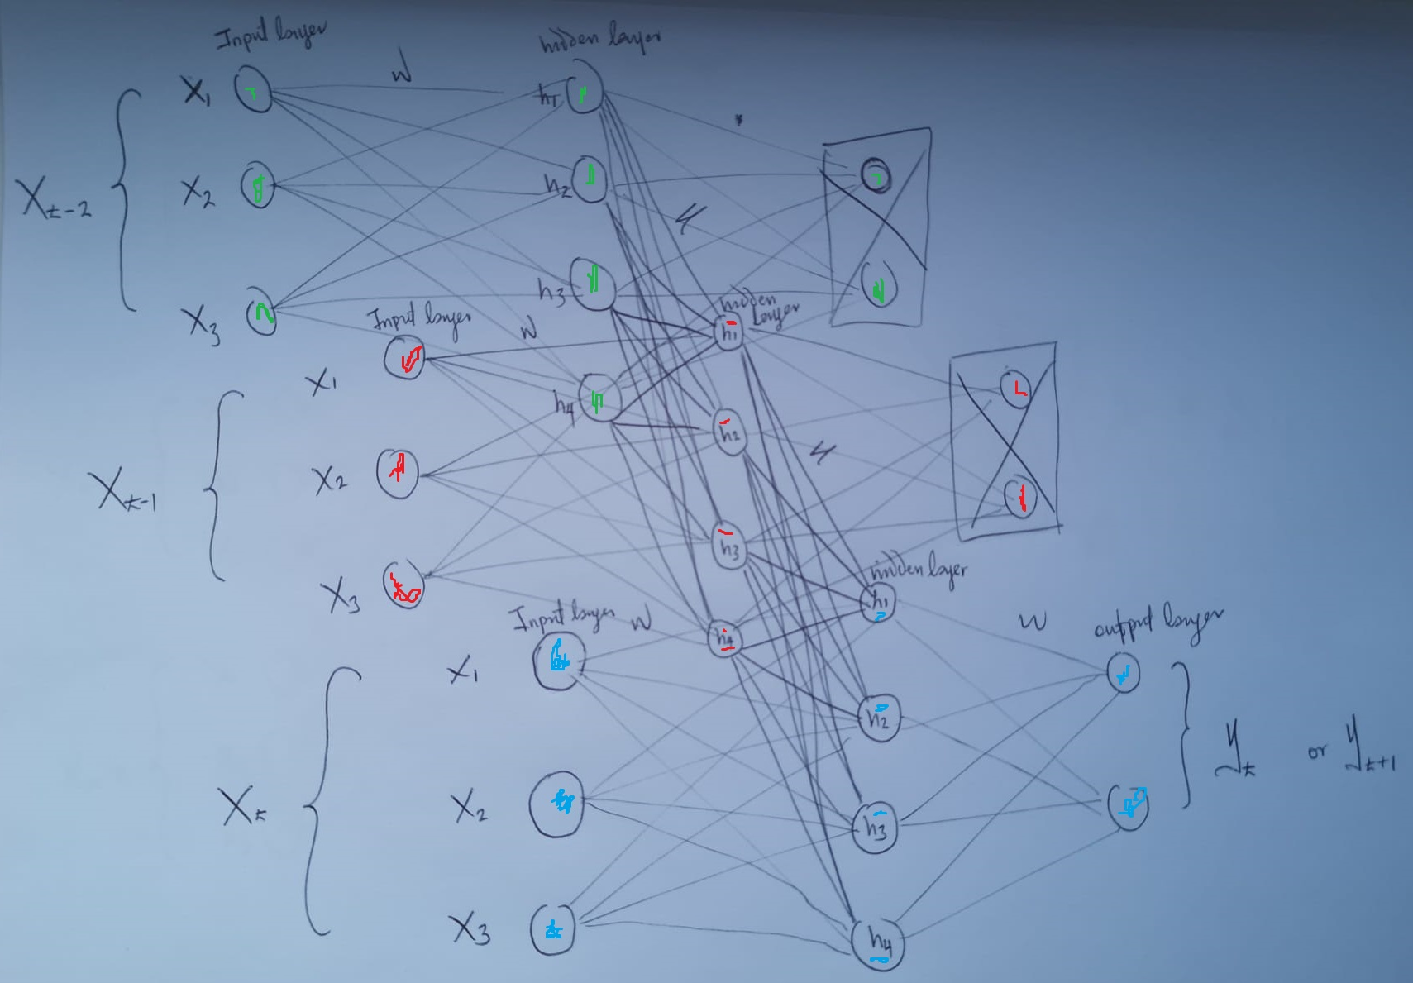
RNN Architecture

Slide 44
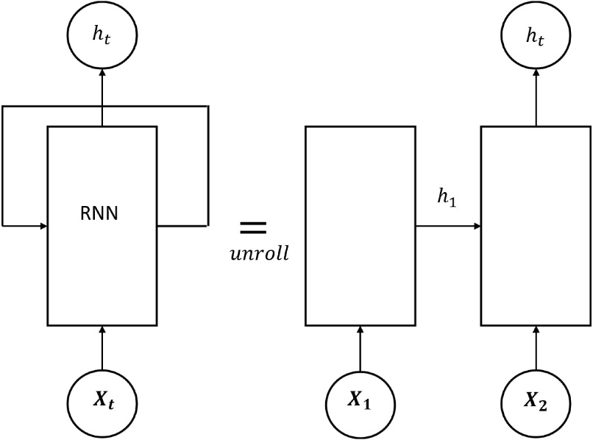
Transforming an RNN into a Feedforward network (Unfolding through time)
The recurrent network can be converted into a feed-forward network by unfolding over time
An unfolded recurrent network. Each node represents a layer of network units at a single time step. The weighted connections from the input layer (x) to hidden layer (s) are labelled ‘U’, those from the hidden layer to itself (i.e. the recurrent weights) are labelled ‘W’ and the hidden to output
(o) weights are labelled ‘V’. Note that the same weights are reused at every time step.

Slide 45
Training RNNs – a summary
Training a RNN is similar to training a traditional Neural Network, and the BP is used with a little adjustment.
Since the parameters are shared by all time steps in the network, the gradient at each output depends not only on the calculations of the current time step, but also the previous time steps.
In order to calculate the gradient at “t=k” we would need to backpropagate “k-1” steps and sum up the gradients. This is called Backpropagation Through Time (BPTT).
It is recommended to convert the RNN into a layered, feedforward net and then train the feed-forward net with the BP algorithm
http://www.wildml.com/2015/09/recurrent-neural-networks-tutorial-part-1-introduction-to-rnns/

Slide 46
RNNs’ summary
Be aware of the fact that the RNNs trained with BPTT have difficulties learning long-term dependencies (e.g. dependencies between steps that are far apart) due to what is called the vanishing/exploding gradient problem.
Backpropagation will be very expensive for a 1,000 item sequence equivalent to a 1,000-layerfeed-forward network (e.g., video segmentation cannot be done by RNN).
Truncated BPTT - backpropagate through just a few time steps (e.g. 10 to 20 time steps).

Slide 47
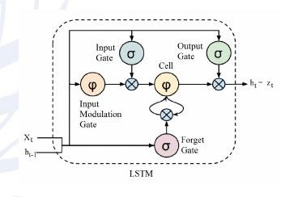
LONG SHORT-TERM MEMORY (LSTM)
An LSTM is a special kind of RNN architecture, capable of learning long-term dependencies.
LSTMs are explicitly designed to avoid the long-
term dependency problem.
An LSTM can learn to bridge time intervals in excess of 1000 steps.
This is achieved by multiplicative gate units that learn to open and close access to the constant error flow.

Slide 48
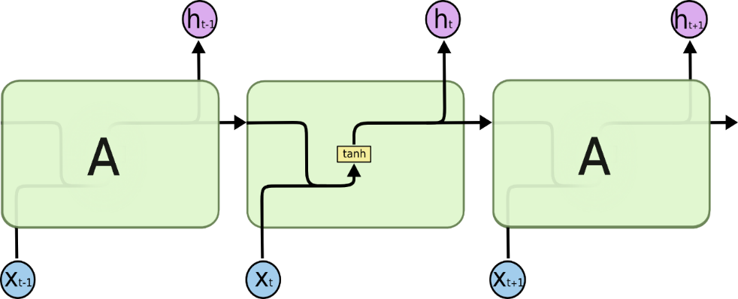
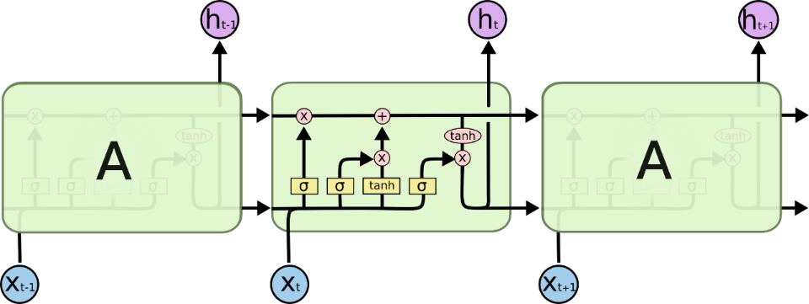
RNN vs. LSTM
Based on a standard RNN (with a single layer) whose neuron activates with “tanh”...
The repeating module in an LSTM contains four interacting layers.
Figure: Cristopher Olah, “Understanding LSTM Networks” (2015)

Slide 49
RNN vs. LSTM
LSTM models are designed to overcome the vanishing gradient problem, which is a common problem in RNNs.
The vanishing gradient problem is a problem that occurs in training recurrent neural networks (RNNs). It occurs when the gradients used to update the weights of the network become very small, making it difficult for the network to learn.
The vanishing gradient problem is caused by the fact that RNNs use recurrent connections. Recurrent connections allow the network to learn long-range dependencies in the data, but they also make the network more prone to the vanishing gradient problem.

Slide 50
Let’s build our
RNN/LSTM model
Access Google Colab Notebook:
https://colab.research.google.com/drive/10iYcP1wN1Kn-RwhJgzBcySXGBNR0uJM_?usp=sharing
Check out the code under “Recurrent neural network (RNN) Example” section

Slide 51
Module 3 – Reinforcement Learning

Slide 52
Reinforcement learning
Reinforcement Learning (RL) is a type of machine learning where an agent learns to make decisions by interacting with an environment, taking actions, and receiving rewards or penalties (feedback) for those actions, aiming to discover a strategy (policy) that maximizes cumulative reward over time through trial and error, much like humans learn.
It's distinct from supervised learning because there's no pre-labeled data; the agent figures out what's right by exploring and exploiting its experiences, balancing trying new things (exploration) with using known good actions (exploitation).

Slide 53
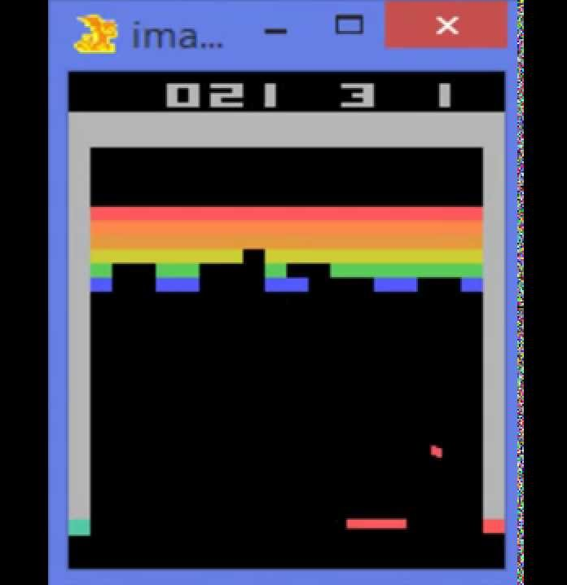
It was kickstarted with Atari games
In 2015, DeepMind introduced and agent that learns to play Atari game directly from input pixel; published in Nature.
Paper link: https://www.cs.toronto.edu/~vmnih/docs/dqn.pdf

Slide 54
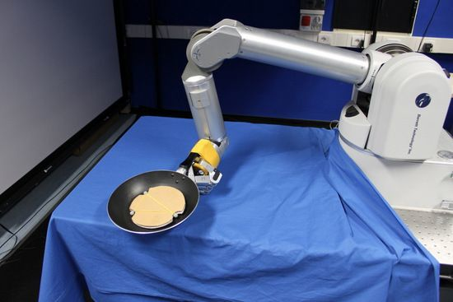
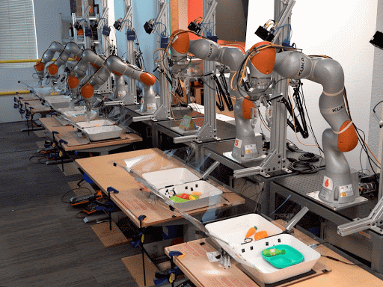
Other applications of RL (Robotics)
Cooking
Placing objects

Slide 55

Other applications of RL (Supply Chain)
Optimizing waste in Supply Chain: SmartNoshWaste
Link: https://www.mdpi.com/2624-6511/5/1/11

Slide 56

RL: The core concept
Reinforcement learning (RL) is a type of machine learning algorithm, where an intelligent agent, which is a computing system that perceives its environment to take actions autonomously in order to achieve cumulative rewards based on the knowledge gathered from the environment.

Slide 57
Reinforcement learning involves
Optimization
Delayed consequences
Exploration
Generalization

Slide 58
Differences between RL vs ML
RL | ML
Optimization | Optimization
Generalization | Generalization
Exploration | Planning (may involve)
Delayed Consequences | Delayed Consequences (may involve)

Slide 59

Sequential decision making
Goal: Select action to maximize total expected future reward
May require balancing immediate and long-term reward
May require strategic behaviour to achieve high rewards

Slide 60
Sequential decision making:
How the world changes
Deterministic: Given a history & action, single observation and reward
Stochastic: Given a history and action, many potential observations & rewards

Slide 61
Q Learning (RL)
Q-learning is a popular reinforcement learning algorithm that can be used to train a Mars rover (intelligent agent) or similar agents to navigate its environment.
The algorithm works by learning the value of each state and action pair. The value of a state-action pair is the expected reward that the rover will receive if it takes that action in that state.

Slide 62
Q Learning in practice
Access the Google Colab notebook to try out Q Learning based RL example: https://colab.research.google.com/drive/1YRwh7a7p_5TvpLO_HcyTnKNBSju_0yk3?usp=sharing

